Slide 1
Intro to JavaScript
3.6
Introduction to the DOM

Slide 2
Introduction

Slide 3
ReCap

Slide 4
Anatomy of a website
Your Content
Plus HTML for structure
Plus CSS for presentation
Equals
YOUR WEBSITE
We use HTML and CSS to give form and style to the content

Slide 5
HTML
STRUCTURE

Slide 6
CSS
Style

Slide 7
IDs and Classes
ID
#prefix in CSS
Should only apply to one element on a webpage, i.e., you might have an id of banner on your webpage's banner.
Class
.prefix in CSS
Lots of elements can have the same class, i.e., There can be many elements with a warning class on one webpage.

Slide 8
Nesting
All the elements of the page next inside one another - a span might be inside a link, that is inside a paragraph, that is inside a div, inside a section, inside the body, inside the html.
Html
Head
Body
Header
Main
Paragraph
Link
Span
Paragraph
Footer

Slide 9
The DOM Tree
<!DOCTYPE html> <html> <head> <title>Test Page</title> <style> h1 { color: red; } </style> </head> <body> <h1>My Page</h1> <p>Hello World!</p> <img src="/img/cakes.jpg" alt="cakes on a plate"/> </body> </html>

Slide 10
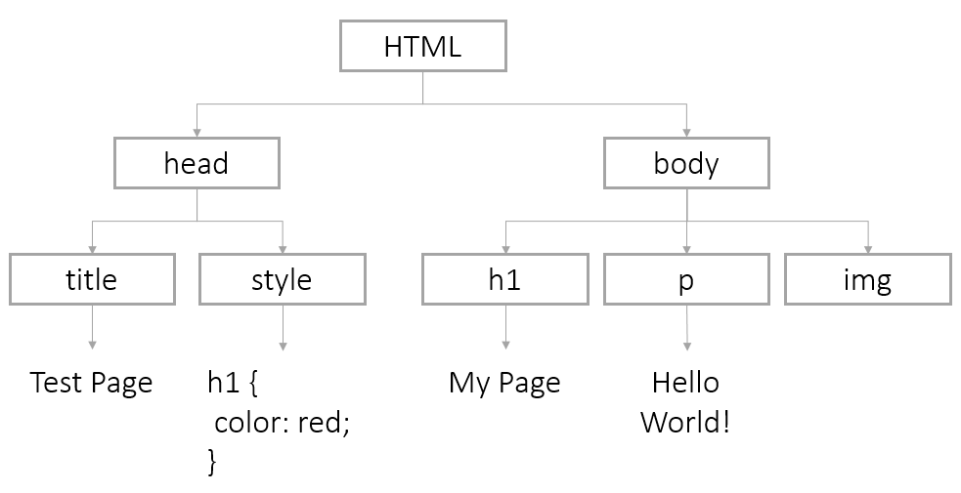
The DOM Tree
All HTML docs are in a tree structure defined by the
DOM (Document Object Model)

Slide 11
Accessing the DOM
The browser loads the content of the webpage into a Document object.
With JS we can use the document to change the content tree.
We can also access or replace any of the existing DOM nodes (HTML elements) or even build an entire html page from scratch

Slide 12
Finding Nodes

Slide 13
Access the DOM by ID
Find nodes by id using
document.getElementById(id);
E.g. to find this image
<img id="cakePic" src="img/cake.jpg" alt="cake"/>
We could use
var imgCake = document.getElementById('cakePic');

Slide 14
Access the DOM by Tag Name
HTML elements by the tag
document.getElementsByTagName(tagName);
E.g. to find
<ul> <li>Daisy</li> <li>Tulip</li> </ul>
We could use
var listItems = document.getElementsByTagName('li'); for (var i = 0; i < listItems.length; i++) { var listItem = listItems[i]; }

Slide 15
HTML 5
Newer browsers can use methods getElementsByClassName, querySelector, and querySelectorAll.
Available in IE9+, FF3.6+, Chrome 17+, Safari 5+:
Available in IE8+, FF3.6+, Chrome 17+, Safari 5+:
document.getElementsByClassName(className);
document.querySelector(cssQuery); document.querySelectorAll(cssQuery);

Slide 16
getElement Vs. getElements
Any method that starts with getElement will return a single node.
document.getElementById('uniqueID'); // returns a single node
Any method that starts with getElements will return an array of nodes.
To modify a single node, you’ll need to use bracket notation to get the one you want.
document.getElementsByTagName('p'); // returns multiple nodes var specificParagraph = document.getElementsByTagName('p')[2];

Slide 17
Changing Nodes

Slide 18
DOM nodes - Attributes
We can access and change attributes of DOM nodes using dot notation
We could change this element
<img id="cakePic" src="/img/cake.jpg" alt="Cake"/>
By switching out the source image for a different one
var imgCake = document.getElementById('cakePic'); // will return src attribute on image imgCake.src // will set our src to a new src imgCake.src = '/img/big-cake.jpg';

Slide 19
DOM Nodes - Getting/Sharing Attributes
You can also use getAttribute or setAttribute
We could change this element
<img id="cakePic" src="/img/cake.jpg" alt="Cake"/>
By switching out the source image for a different one
var imgCake = document.getElementById('cakePic'); // will return src attribute on image imgCake.getAttribute('src'); // will set our src to a new src imgCake.setAttribute('src', 'http://placekitten.com/g/600/500');

Slide 20
DOM Nodes - Styles
You can change page css using style
For this CSS
body { color: red; }
We’d use this JS
var pageBody = document.getElementsByTagName('body')[0]; pageBody.style.color = 'red';

Slide 21
DOM Nodes - Styles Extra
The rule of thumb in JavaScript is to change CSS styles with a "-" to camelCase.
For this CSS
body { background-color: red; padding-top: 10px; }
We’d use this JS
var pageBody = document.getElementsByTagName('body')[0] pageBody.style.backgroundColor = 'red'; pageBody.style.paddingTop = '10px';

Slide 22
Task 3.6.1
Create a simple HTML page
Isolate a node on the page and change an attribute
Isolate a different node and add a new style to it
Notes:
Task 3.6.1

Slide 23
DOM - innerHTML continued
You can also target one specific element's content
To put something in this specific paragraph
<p id="warning"></p>
..we can select the node and modify it
var warningParagraph = document.getElementById('warning'); warningParagraph.innerHTML = 'Danger Will Robinson!';

Slide 24
Creating new nodes from scratch
The document object also has methods to create nodes from scratch:
document.createElement(tagName); document.createTextNode(text); element.appendChild(element);

Slide 25
Task 3.6.2
Create a new paragraph element and add it to a div on your page
Notes:
Task 3.6.2

Slide 26
Creating New Nodes
var pageBody = document.getElementsByTagName('body')[0]; // create our image tag with attributes var newImg = document.createElement('img'); newImg.src = 'http://placekitten.com/g/500/200'; newImg.style.border = '1px solid black'; // add our image to the body pageBody.appendChild(newImg); // create a paragraph tag with content var newParagraph = document.createElement('p'); var paragraphText = document.createTextNode('Squee!'); newParagraph.appendChild(paragraphText); // add our new paragraph to the body pageBody.appendChild(newParagraph);

Slide 27
Events

Slide 28
Events
An event is an object that is sent when actions take place on your webpage, most often when a user interacts with your webpage.
For example, JavaScript creates an event when a user clicks an element.
element.addEventListener('click', function(event) { // code to be executed when user clicks });

Slide 29
Types of Events
There are a variety of events. Some of the more common events are:
click: Occurs when the user clicks on an element
mouseover: Occurs when the pointer is moved onto an element
mouseout: Occurs when the pointer is moved off an element
keyup: Occurs when the user releases a key
load: Occurs when a document has been loaded
focus: Occurs when an element gets focus
blur: Occurs when an element loses focus

Slide 30
Calling Functions from JavaScript
We can call a function from the addEventListener
<button id="myBtn">Click Me!</button>
var button = document.getElementById("myBtn"); button.addEventListener("click", function (event) { alert("Hi!"); });
...OR
var button = document.getElementById("myBtn"); var sayHi = function (event) { alert("Hi!"); }; button.addEventListener("click", sayHi);

Slide 31
Task 3.6.3
Make an alert pop up from a mouseover event
Notes:
Task 3.6.3

Slide 32
Preventing Defaults

Slide 33
Preventing Defaults
Elements like links and checkboxes have default behaviors determined by the browser. However, the event object has a built-in method to prevent the default behavior
Here’s an anchor link
<a id="myLink" href="https://leedswebdev.org">Leeds Web Dev Meet-up</a>
...and here’s the code to prevent the click going to the href
var link = document.getElementById("myLink"); link.addEventListener("click", function(event) { event.preventDefault(); });

Slide 34
Current Target

Slide 35
Current Target
The event's currentTarget references the element the event listener was attached to.
Here’s some button HTML
<button id="myBtn">Click IT!</a>
...and here’s the code to add styles to the clicked button
myButton = document.getElementById("myBtn"); myButton.addEventListener("click", function(event) { btn = event.currentTarget; btn.style.backgroundColor = 'red'; btn.innerHTML = 'Clicked!'; };
You may also see code that references the keyword this as the "target".

Slide 36
Task 3.6.4
Write some code to target a link to LeedsWebDev.org
Instead of following the link, when a user clicks have an alert message pop up.
Notes:
Task 3.6.4

Slide 37
User Input

Slide 38
Forms
We can collect info from our users to use in our code - most commonly this is done through HTML forms
<form id="userForm"> <label for="name">First Name:</label> <input type="text" id="firstName"/> <input type="radio" name="married" value="Yes" checked /> Yes <input type="radio" name="married" value="No" /> No <input type="submit" id="submitBtn" value="Submit" /> </form>

Slide 39
Retrieving Form Data
We retrieve the values of form elements using the value method.
var name = document.getElementById('firstName').value; console.log(name);
You can retrieve the value of a form at any time. Even when an event like blur is triggered (when a form element loses focus).

Slide 40
Radio Buttons
Radio buttons usually do not have IDs, so you will need to use a for loop to get the value on each radio:
var radios = document.getElementsByName('married'); var length = radios.length; for (var i = 0; i < length; i++) { if (radios[i].checked) { var radioButtonValue = radios[i].value; // only one radio can be checked, so stop now break; } }

Slide 41
Submit Buttons
If you are going to retrieve form values with the submit button, be sure to prevent the default action!
var submitButton = document.getElementById('submitBtn'); submitButton.addEventListener("click", function(event) { event.preventDefault(); var name = document.getElementById('firstName').value; console.log(name); })

Slide 42
Task 3.6.5
Collect a value from the input box on the page. Use it inside a function of some kind. For example, collect a number and multiply it by five or collect a name and display a greeting.
Create an HTML Form
Notes:
Task 3.6.5

Slide 43
YOU DID IT

